Slide 1
NJR Medical
"Helping Medicine Help People"
P.O. Box 582, New York City, NY 10021
www.NJRmedical.com
Tel: 877.318.5162
Fax: 866.412.8790
Email: info@NJRmedical.com
Presentation of The No-Bite V™
For: Product Committee &
Value Analysis Meetings
***presentation available on our website www.njrmedical.com under the section “Learning Center”

Slide 2
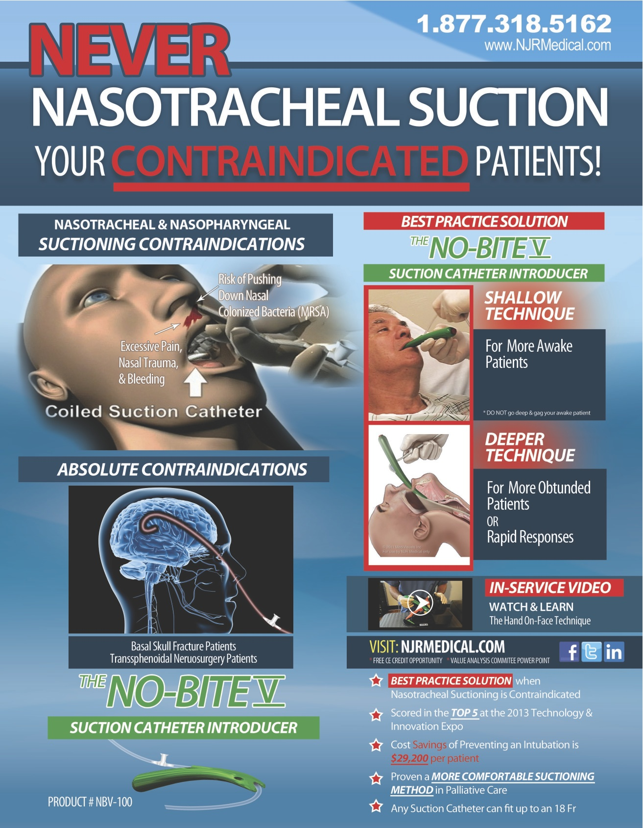
No-Bite V™ – Scored in the Top 5 at the 2013 Technology & Innovation Expo!
The No-Bite V™ (part# NBV-100)
(Suction Catheter Introducer for Oral Airway)
Value Analysis Presentation- Online in section, “LEARNING CENTER”
Free CEU’s & In-Service Videos – www.NJRmedical.com
Best Practice Solution when Nasal Suctioning is Contraindicated
  If a patient has a contraindication to nasal route suctioning, the patient cannot effectively be suctioned in a deep manner. If excess secretions & respiratory distress persists, the patient could have to be intubated because they can not clear their secretions effectively by themselves.
Cost savings for preventing an average, non-complicated intubation is $29,200 per patient
  No-Bite V is part of a must have protocol to prevent inadvertent intracranial insertion of nasotracheal suction catheters in Basal Skull Fx. or Transsphenoidal Neuro-Surgery Patients
  No-Bite V has also proven to be a more comfortable route of suctioning in Hospice & Palliative Care

Slide 3
What is The No-Bite V ?
(quick in-service video)
Go to website www.NJRmedical.com to watch:
“No-Bite V In-Service Video”
*** First video on right hand side of page as you scroll down

Slide 4
Cost Savings of Preventing an Intubation is $29,200 per
Patient
The equation is as follows:
If a patient has a contraindication to nasal route suctioning, the patient cannot effectively be suctioned in a deep manner. If excess secretions & respiratory distress persists, the patient could have to be intubated because they can not clear their secretions effectively by themselves.
With the No-Bite V, one can now effectively suction that nasal suction contraindicated patient that could not be suctioned before. It’s a proven fact that deep suctioning has shown to prevent intubations and the No-Bite V facilitates just that. Cost savings for preventing an average, non-complicated intubation is $29,200 per patient with an average additional hospital stay of 7 days. An intubation that becomes complicated can be a much higher cost.

Slide 5
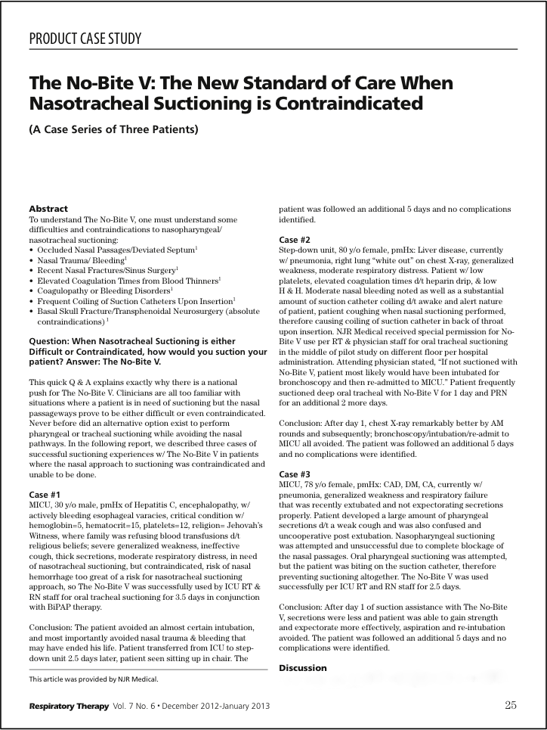
Published Case Series in Respiratory Therapy Magazine
The No-Bite V proves to prevent intubation and therefore saves hospitals an average of $29,200 per prevented intubation.
*Full Articles @ www.NJRmedical.com

Slide 6
A More Comfortable Suctioning Method in Hospice and Palliative Care
*Full Articles @ www.NJRmedical.com

Slide 7
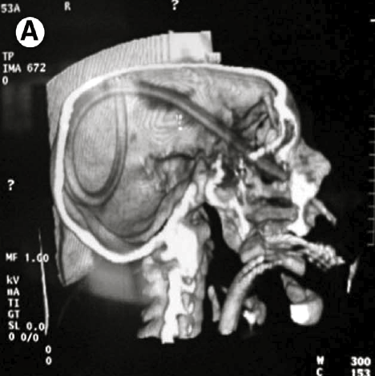
Avoid a
Sentinel Event
A Must-Have protocol for at-risk patients with Basal Skull Fractures or Transsphenoidal
Neuro-Surgeries
*Full Articles @ www.NJRmedical.com

Slide 8
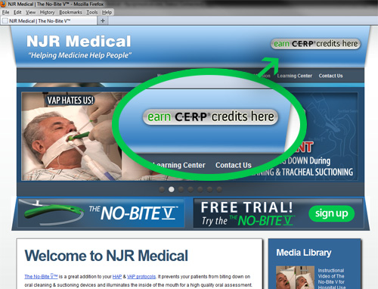
In-servicing can be done via our website learning module and all Respiratory Therapy and Nursing Staff receive 0.5 CE credit hours for successfully completing the No-Bite V Course.

Slide 9
References for No-Bite V
NYU Medical Center- NY
St.Barnabas Hospital System-NJ
University of Arizona Medical Center - AZ
Dignity Health, CA
Nationwide Children’s Hospital, OH
Via Christi Health-Wichita, KS
University Hospitals-SW General Cleveland, OH
Les Turner ALS Foundation- IL
Hospice Care of Rhode Island

Slide 10
The No-Bite V (Product # NBV-100)
Packaged 24 No-Bites in 1 Box
Keys to Remember:
No-Bite V is a non-competitive product, no other product can do its job
No-Bite V can be used multiple times on same patient w/ cleaning protocol
No-Bite V is only used on difficult suctioning patients, not something you use a lot, but when you need it, you will be very happy you have it!
Intubations, Re-Admissions to ICU’s and Length of Stay can all be reduced
If you have any questions or require any further information concerning NJR Medical & The No-Bite V, please contact me at your convenience:
Nicholas Pastron, CEO
Nicholas.Pastron@NJRmedical.com
Tel: 877-318-5162
Cell: 440-258-8204
Fax: 866-412-8790

